Slide 1
Northern Star Scouting
2022 Popcorn Kickoff

Slide 2
Secret Agent
Bill
Anderson-Horecka
Staff advisor - Northern Star Scouting

Slide 3
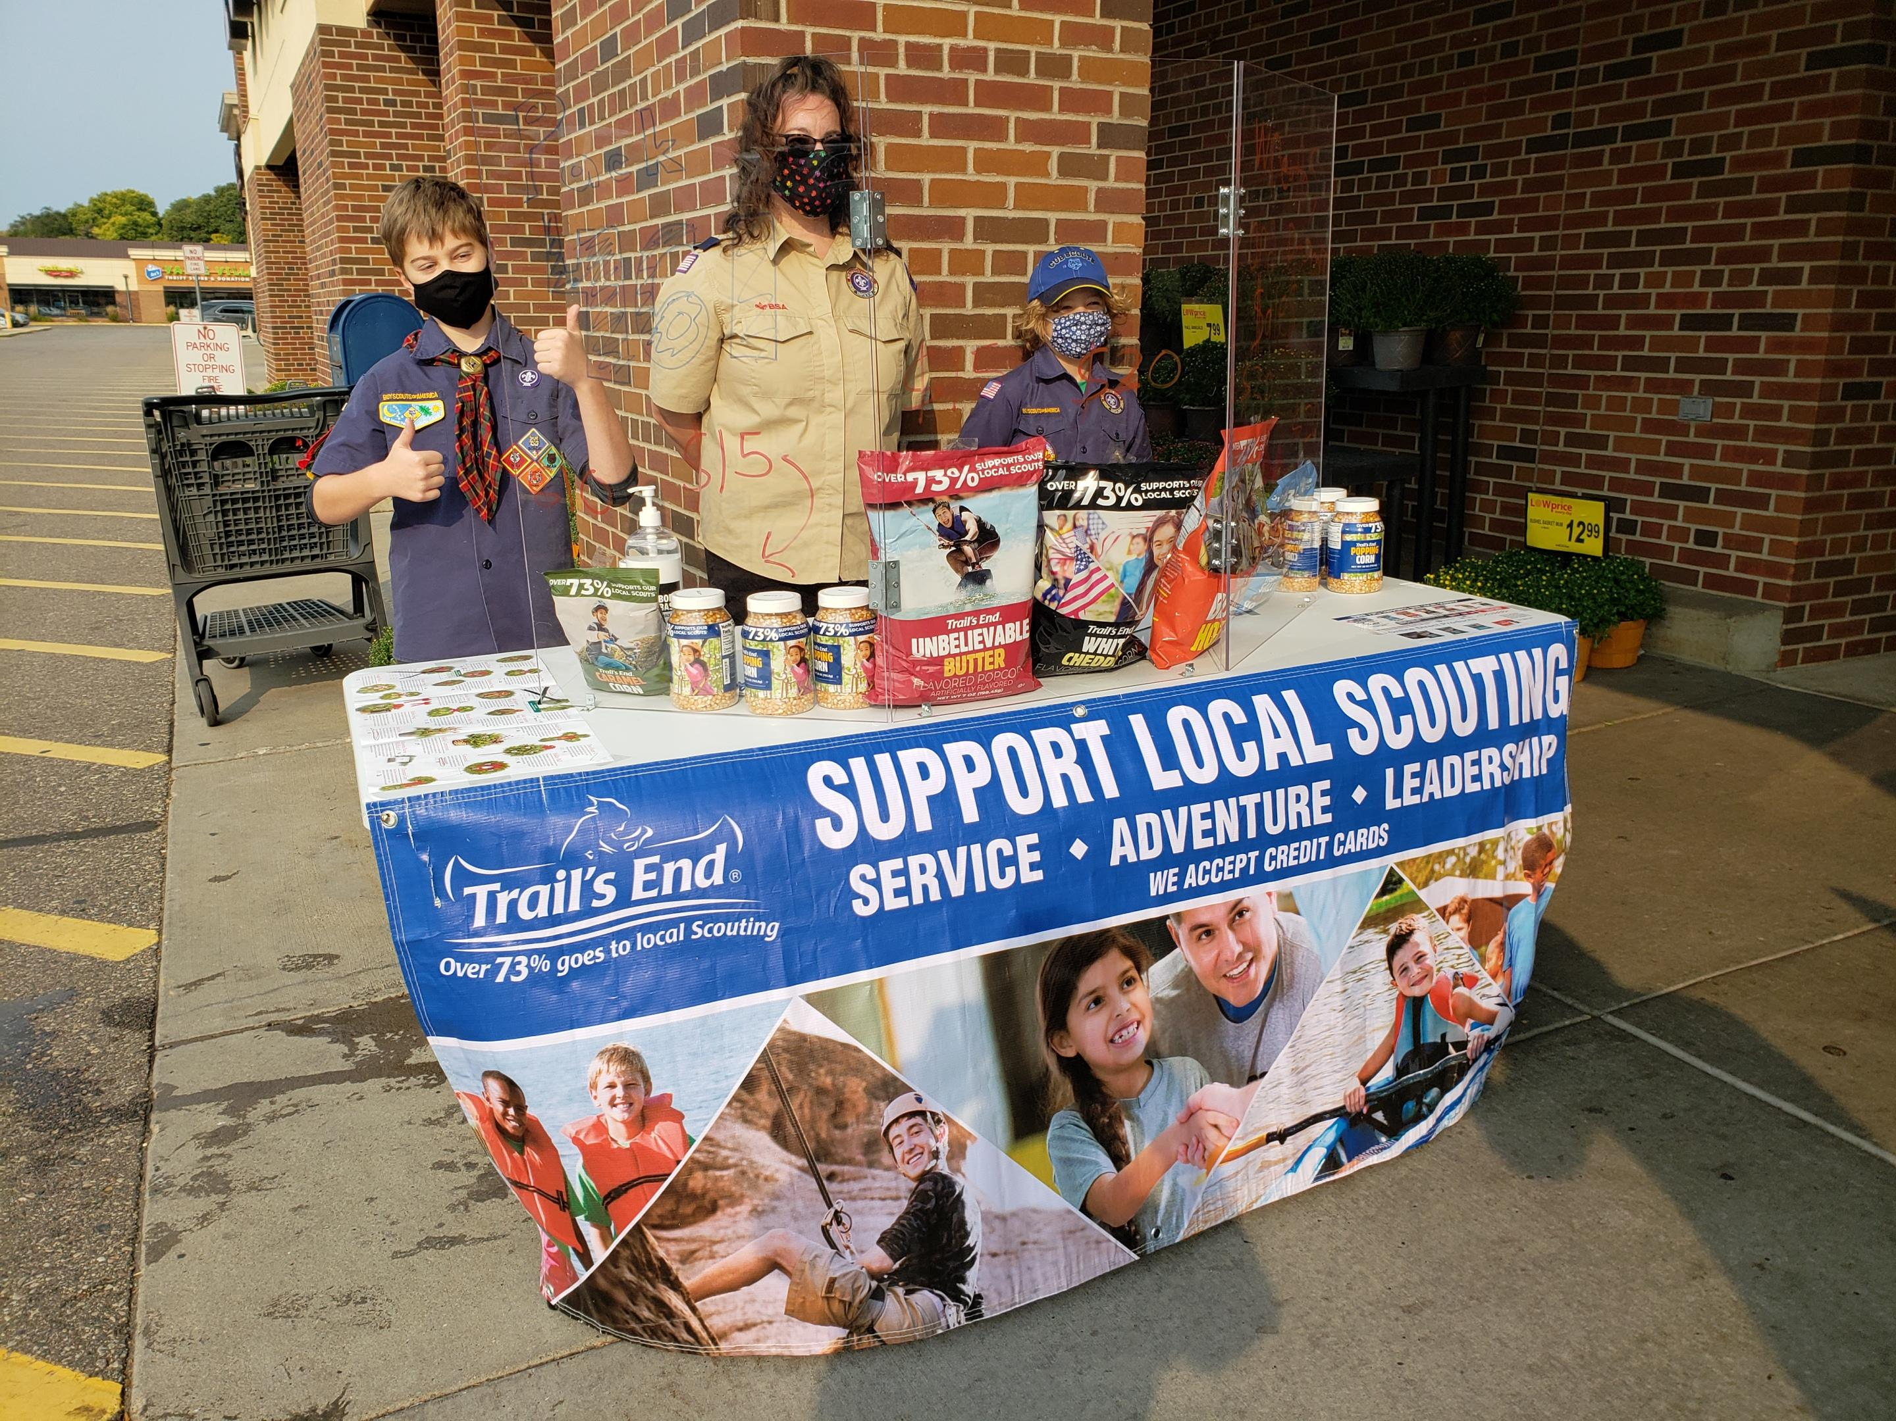
WHY Do WE SELL Popcorn?
73% Return to Scouting
Fund our unit’s Scouting program
Scout character development
Improve our camps and council resources
OVER $1.89 million Returned to Northern Star Scouting in 2021

Slide 4
SALE SAFETY
Our goal is to have every Scout, parent and customer feel safe about each transaction.
Northern Star is utilizing -
Minnesota Department of Health Guidelines
You can also use -
Local City guidelines
What feels safe to each family

Slide 5
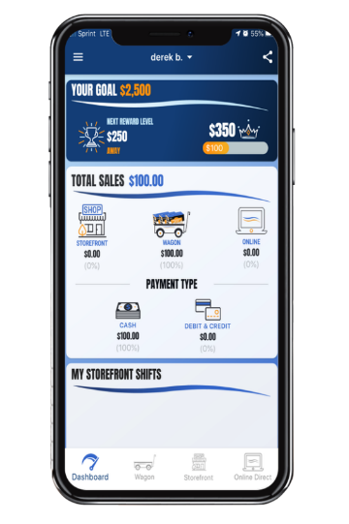
Trail’s End App
Key Benefits
Free Credit Card Processing - Paid by Trail's End
Real-time tracking and reporting of sales, inventory and storefront registrations
Families can turn in cash payments via credit card
System-calculated Scout sales for easy Trail's End Rewards ordering
Take Online Direct orders in the app as way to fundraise while social distancing
Advancements that can be earned are now in the app!
Proven Results
Used by over 14,500 units & 160,000 Scouts
Over 10% growth for units that recorded more than 75% of sales in the app in 2019​
Credit Card transactions averaged 27% higher than cash
Text APP to 62771 to download the App.
Text APPGUIDE to 62771 to download the App Quick Start Guide.

Slide 6
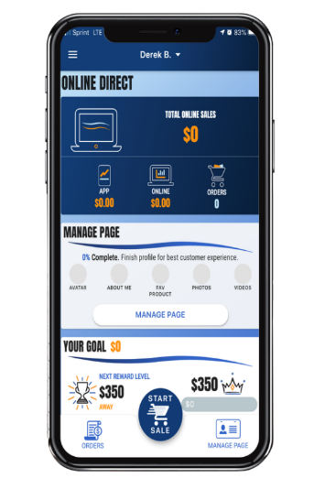
Trail’s End Improvements
App Improvements​​​
Faster, more intuitive Scout registration​
Faster checkout (From 9 to 4 clicks)​
List, grid and product detail views​
Record online orders directly in app​​
Sharable online cart so customer can enter shipping address and complete payment – great for social distancing!
New undelivered logic for Wagon Sales so Scouts enter them correctly​
Credit payment option for parents to pay cash owed to unit​
Improved Trail’s End Rewards​​ focused on reaching next level and goal​
Unit Leader Portal​​ Improvements​
Onscreen guides to help leaders learn Unit Leader Portal features
Consolidated Scout table view to quickly manage orders, inventory, and storefront shifts
Robust products table to easily view inventory at storefronts and with Scouts​
Ability to convert orders between Wagon to Storefront
Ability to change the shift credited to a storefront order

Slide 7
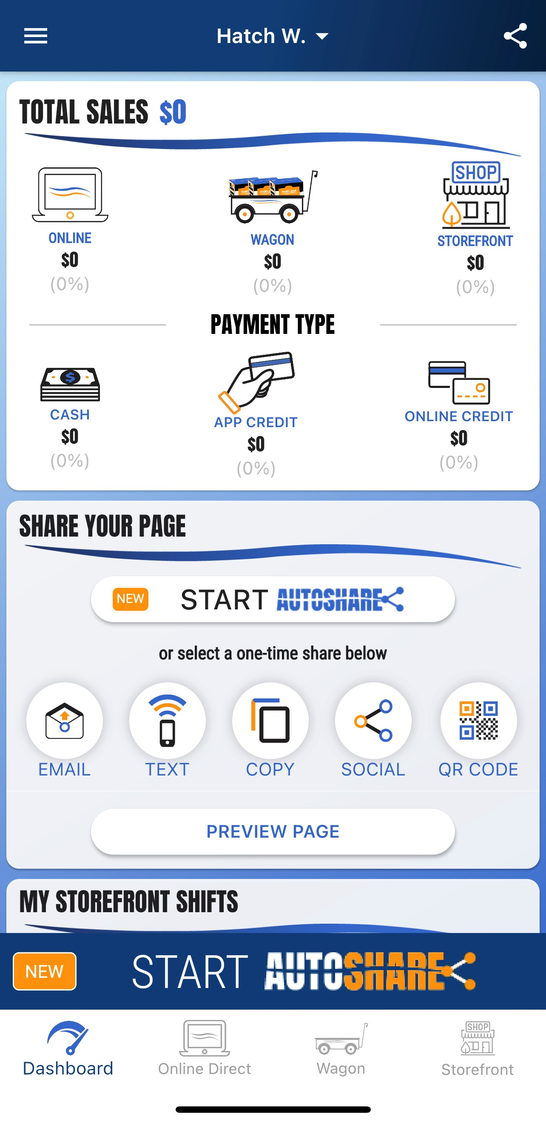
Trail’s End App - Autoshare
Auto Share
Enables Scouts to share their fundraising page
• Share with contacts in mobile device
• Share with prior Customers
• One-time or several Autoshare options
Step 1-Pick a Campaign—Top Seller, Seasonal Seller, Quick or One Time Share
Step 2—Select Contacts and Customers. You can select all or one by one.
Step 3—Review your selection and hit submit
Notes about AutoShare:
• If a customer clicks on the AutoShare link you send them, AutoShare with stop until you AutoShare with them again.
• Contacts import—Quick way is to allow TE to access the contacts on the phone. You can also manually enter them. TE will not access contacts without permission.
Only Scout accounts can log into the app. Leader accounts will not allow access.

Slide 8
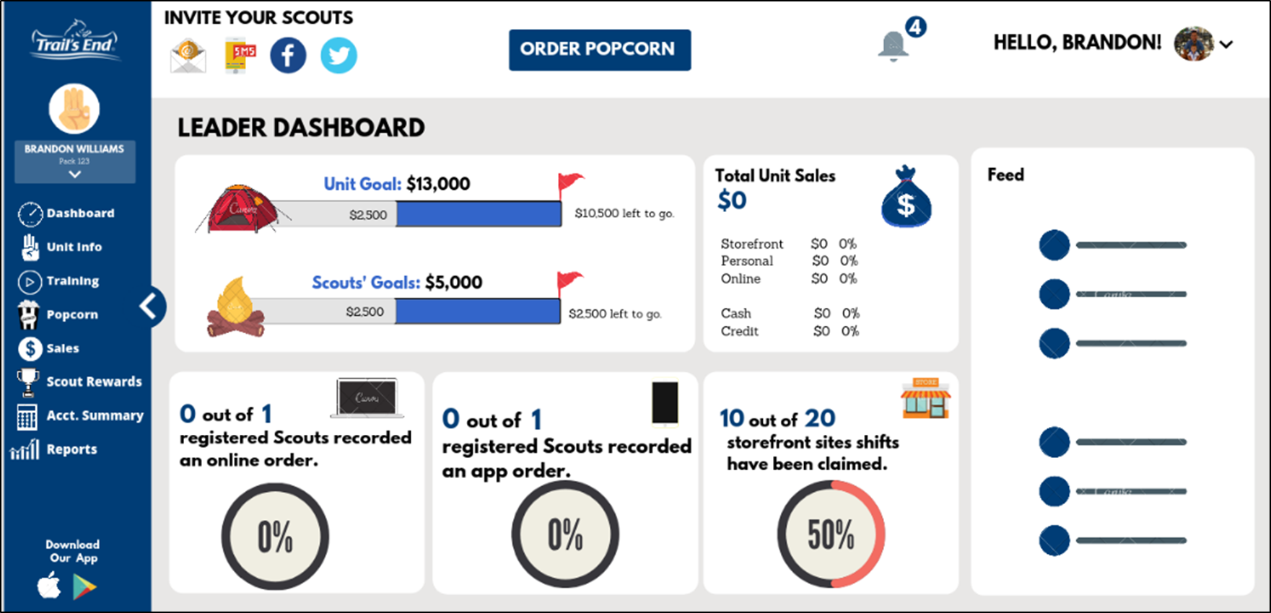
Trail’s End Leader Portal
One Platform to Manage Your Fundraiser
Now Mobile Friendly!
Track All Scout Sales - Easily view and manage all app and online Scout sales in real-time.
Manage Inventory - Keep track of inventory levels and know where products are in real-time.
Coordinate Storefront Sites & Shifts - Create schedule for Scouts to sign up for booths you reserve in your community.
Place Popcorn Orders - Order popcorn for your council’s scheduled pick-ups.
Submit Rewards - Submit Trail’s End Reward orders for Scouts.
Move Scouts -Scouts can now be moved by Chairs or Scouts themselves
Login at: www.Trails-End.com with your Trail’s End Leader account.

Slide 9
Ways to Sell

Slide 10
Product Update – Available Wagon Sale Products
NEW FOR 2022
New mix White Cheddar and Kettle Corn
Not available until Sept 22
NEW FOR 2022
$5 Price increase on these two products

Slide 11
Ordering Info
SHOW AND DELIVER (WAGON) ORDER
DUE Aug 25 at Midnight
Order through the Leader Portal at www.trails-end.com
Up to 80% of what you sold in 2021 (Retail dollars)
Order in full cases only
With the product changes, use your best judgement on what to order based on previous sales and your ordering limit.
We WILL have more product during the sale to check out.
TAKE ORDER DUE NOV 6 at MIDNIGHT
Order through the Leader Portal at www.trails-end.com
Can order singles
Order your Hometown Heroes credits at take order
NOTEABLE FEATURES
What to order auto populate button
Multifactor Authentication – 30 days
Ordering for two Units

Slide 12
Distribution
Show and Deliver Pick Ups
Sept 15 or 16
Several Locations Around Council
Reordering Starting Tues Sept 27 Pick up at reorder warehouse or Snack Semi
Home Delivery
Over $12,000 in sales in 2021
Changing to $15,000 in sales in 2022 to qualify for 2023
Must order at least $6,000 or 35% of last year’s sale (whichever is greater)
Need home Delivery Info by Aug 22. We will send out a survey to request the info

Slide 13
Distribution
EARLY RETURNS---any amount
Sunday Oct. 9 and Monday Oct 10 4-7p.m.
No questions asked
Units can only return FULL Cases of product at early return days.
Units will only be able to return up to 15% of their TOTAL Show and Deliver order after Oct 10.
FINAL RETURNS—up to 15%
Thurs. Nov 3 and Sunday Nov 6 4p.m.-7p.m.
4 locations on Thurs
2 Locations on Sunday
Willmar by appointment.
ABSOLUTELY NO RETURNS AFTER NOVEMBER 6

Slide 14
Transfers
All Transfers are done through the
Trail’s End Leader Portal
You can initiate a transfer
Both parties have to accept
Invoice automatically updates for both Units

Slide 15
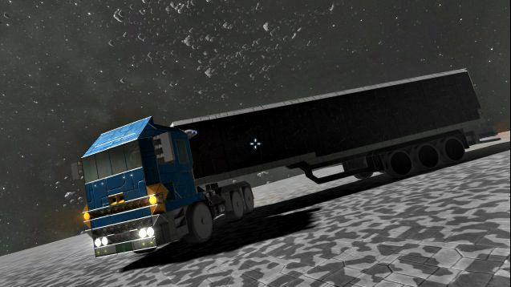
Distribution — Snack Semi
During the sale for reorders you can order from the warehouse OR the Snack Semi.
The Snack Semi is similar to the Amazon Treasure Truck
Order by a certain date each week for pick up around the metro and outlying areas.
Order in full cases
4 days will have stops in 5-8 communities for 30-45 min before moving on

Slide 16
ROUTE 2
ROUTE 1
ROUTE 3
ROUTE 4

Slide 17
Online Direct
Best & Preferred Way to Sell
Safest way for Scouts to sell
Scouts earn 1 Point for TE Rewards
Traditional products and prices
$10 opening price point
No handling of products/cash for Scout or unit
New TE App Online Direct features:
Take Online Direct orders in the TE App
Text order to customer to complete purchase on their phone
Products popped fresh to order – shipped direct to customer.

Slide 18
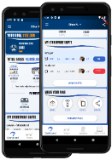
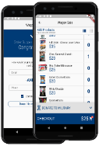
Online Direct
HOW IT WORKS
TWO WAYS TO SELL
SHARE YOUR PAGE
Share your fundraising page via email, text, or social media.
Customers click you link to place online orders.
Products ship to your customers.
TAKE ONLINE DIRECT ORDERS IN THE APP
Pick your products.
Send link to customer via app
Take payment (credit/debit only)
Products ship to your customers.

Slide 19
Online Direct Products

Slide 20
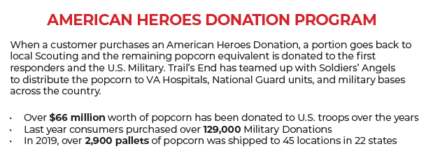
Hometown Heroes
Return product is used to fill our local Hometown Heroes orders
In 2021, over $85,000 was given to local heroes!

Slide 21
Accepting Credit/Debit Cards
CREDIT SALES ARE BEST FOR SCOUTS
TELL YOUR CUSTOMERS, “WE PREFER CREDIT/DEBIT”
Trail’s End pays for all credit card fees!
Bigger Rewards – Earn 1.25pts per $1 sold in the Trail’s End App
Safer – Scouts and Popcorn Kernels don’t have to handle cash
Higher Sales – Customers spent 27% more with credit vs. cash in 2019
Easier – Parents turn in cash sales with credit/debit payments to their unit
Hardware – Scouts can accept credit/debit with Square readers or manual entry

Slide 22
Your Unit Earns
Commission Type: | Commission Percentage:
ONLINE DIRECT* | 35%
TRADITIONAL/WAGON/TAKE ORDER | 32%
Training Bonus | 3%
Cash Option (Troops and Crews) | 4%
*No rewards opt-out available.
Notes:
Opt-Out commissions generally provided 3% of benefit to the Scout, whereas Trail’s End Rewards provides an average of over 5%, and up to 20% benefit to the Scout!

Slide 23
Trail’s End Rewards
Continued in 2022
Points based Rewards system encouraging Scouts to sell more with Online Direct and with credit cards
With changes to the way they sell, Scouts can earn more Rewards faster!
Mission Uncrunchable Week - Sept. 23-Oct. 2 earn 100 points
Here is how any Scout can earn 100 Bonus Points for Amazon Gift Card prizes.
· Create a Scout Trail’s End selling account (or log into your existing one).
· Sell $400 via Credit Card and/or Online sales between Sept. 23 and Oct. 2.
· Trail’s End will deposit 100 bonus points by Oct. 15.

Slide 24
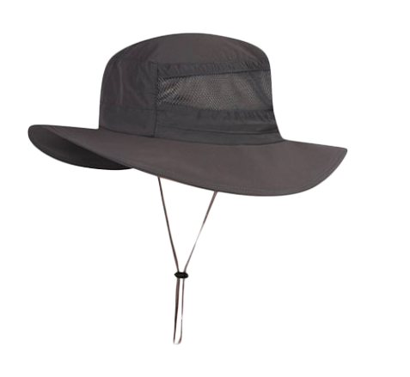
Bonus Prizes
• Bonus Prizes — (All units eligible) Will be handed out at Take Order pick up.
Sell 1 Item— Patch
$800 Club — Logoed Fishing Style Hat
$1100 — Beach Towel or Camp Slushie Cup (good at Tomahawk, Many Point, Navajo
and Phillippo).
• Adventure Prizes —$1800+
• Champions Breakfast —$2500—January 7, 2023 at Base Camp.
Notes:
3 min

Slide 25
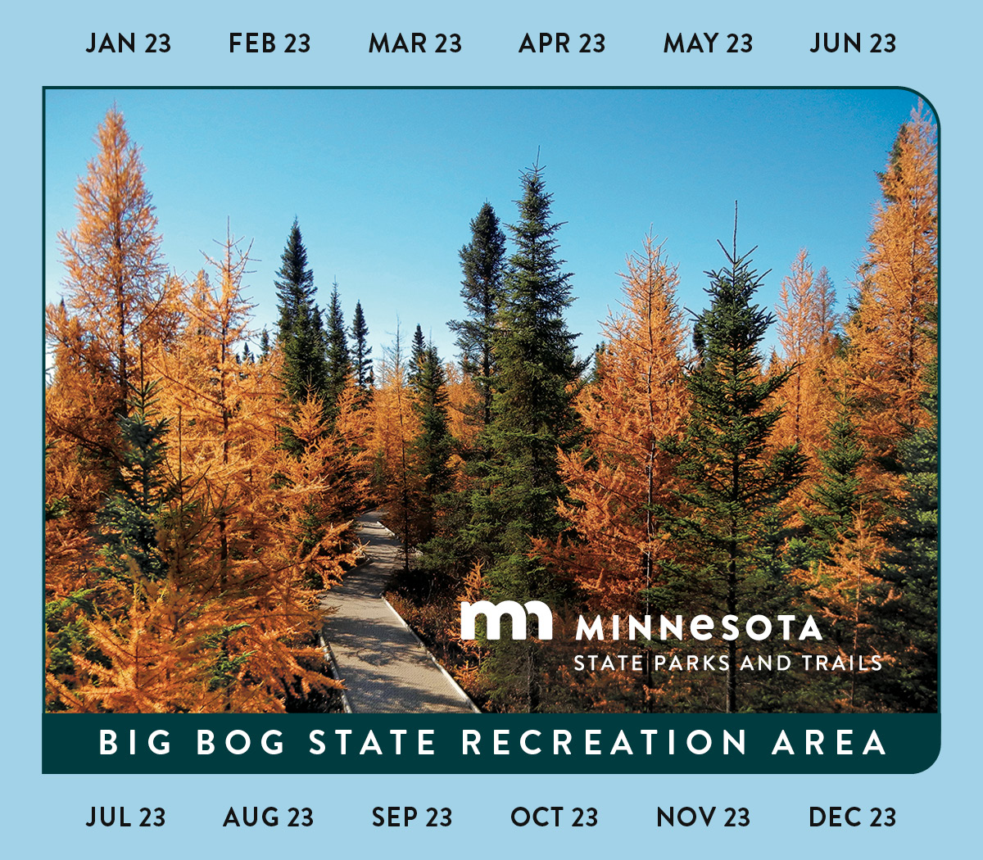
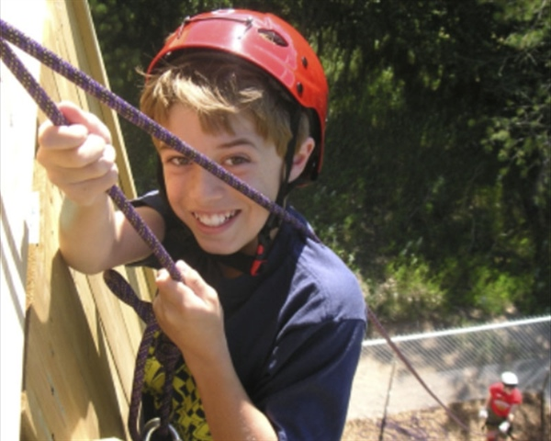
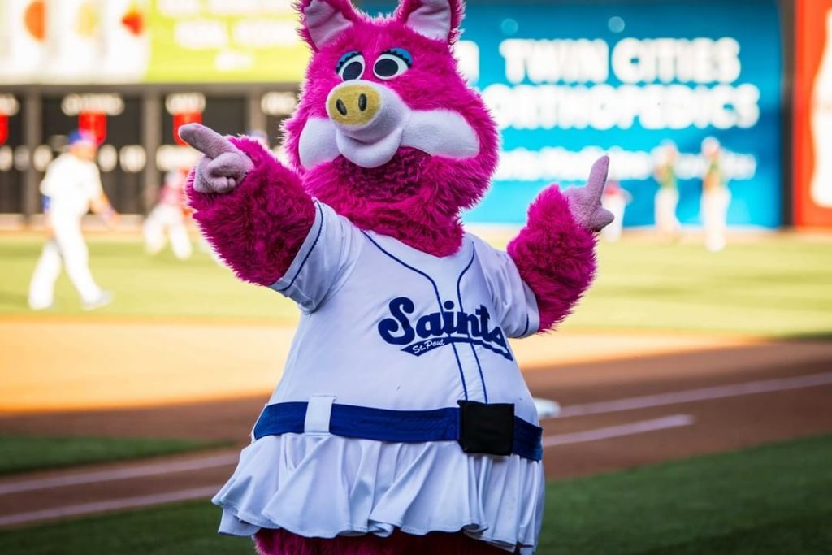
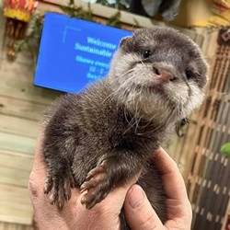
Adventures
Notes:
3 min

Slide 26
SECRET AGENT CAMP
Secret Agent Camp is for all Scouts selling popcorn. Encourage all of your Scouts to attend!
Base Camp
Date/Time: Open house style on Saturday, Sept. 17, 9:00 a.m. - 1:00 p.m.
Location: Base Camp—6202 Bloomington Road, Fort Snelling, MN 55111.
Stations: (subject to change)
Prize Extravaganza/Bonus Prizes/Adventures
Trail’s End App Practice Your Pitch
Hometown Heroes Storefront Safety
AND MORE!
.
Emails with the sign-up information will be sent out early August to all registered Scouts in the Trails End app, as well as unit chairs. Emails will be sent to popcorn chairs to forward to parents and Scouts.
All Scouts who preregister and attend Secret Agent Camp get a Cool Logoed Color changing cup/tumbler and a chance to win prizes, including-
2 Smart TVs
2 Nintendo Switches
1 Xbox
2 Amazon Tablets
And MUCH MUCH MORE!
Notes:
1-2 min

Slide 27
Trail’s End Webinars
Register at: https://www.trails-end.com/webinars
• Registration site is open for training!
• New and existing unit kernels are encouraged to attend.
• First session launches on July 9

Slide 28
Trail’s End Facebook
Text FACEBOOK to 62771 to join!

Slide 29
Important Dates
Pre-Sale Prep
July 30—Aug. 25 Attend Popcorn Training Seminar in person or online
Aug. 1-31 Set Unit & Scout Goals. Set Popcorn Kickoff Date for Sept.
Aug. 1-31 Set up Store Front Sale Locations and Blitz Days
Mon. Aug. 22 Home Delivery Info due 12:00 p.m.
Thurs. Aug. 25 Show & Deliver Order Due at Trails-End.com 11:59 p.m.
Sept. 15-16 District Show and Deliver Pick Up Varies by Area
Sept. 10-21 Home Deliveries Dropped off Varies
Sat. Sept. 17 Secret Agent Camp – Council Kickoff—Base Camp 9:00 am.—1:00 p.m.
During the Sale
Fri. Sept. 23 SALE STARTS! 5:00 p.m.
Sun. Oct. 9/Mon. Oct. 10 Early Returns 4:00 p.m.-7:00 p.m.
Sun. Oct. 30 SALE ENDS! 11:59 p.m.
After Sale Wrap Up
Thurs. Nov. 3 Final Returns Opportunity #1
Sun. Nov. 6 Final Returns Opportunity #2
Sun. Nov. 6 Take Orders Due MIDNIGHT
Nov. 18 Take Order Distribution Varies by area
Nov. 11-18 Take Order Home Deliveries Dropped Off Varies by area
Thurs. Dec. 15 Payments Due Tues. Dec. 15

Slide 30
Trail’s End Resources
Text the keywords below to 62771 to Download.
Leaders | Keyword | Description
 | KERNELGUIDE | Popcorn Kernel Guide (PDF)
 | KICKOFF | Unit Kickoff Presentation (PPT)
 | WEBINAR | Link to Webinar Registration Portal
 | FACEBOOK | Link to join the Trail's End Facebook Group
Scouts | APP | Link to download the Trail's End App
 | APPGUIDE | App Quick Start Guide for Scouts (PDF)
 | MYPLAN | How to Sell $1,000 Social Distancing (PDF)
 | SCOUTFB | Link to join the Trail's End Scout Parents Facebook Group
 | REWARDS | Trail's End Rewards Flyer (PDF)

Slide 31
Contacting support
CONTACT TRAIL’S END SUPPORT
JOIN OUR FACEBOOK GROUP
Trail’s End Popcorn Community
VISIT OUR WEBSITE
www.Trails-End.com
EMAIL US:
Support@trails-end.com
NEED HELP? VISIT OUR FAQs:
www.Support.Trails-End.com
Have a question or a few? Swing by our Trail's End Popcorn Community Facebook page every Wednesday starting Wednesday, July 27th at 7pm EST through Wednesday, November 9th at 7pm and we'll be LIVE to help answer any questions that come through.

Slide 32
What should you do now?
Attend a Trails End Webinar
Survey your Scout parents to get a feel if they will sell
Log into the leader portal at www.trails-end.com
If you don’t have a working login/password, email popcorn@nsbsa.org, make sure to include your Unit and Name.

Slide 33
COUNCIL CONTACT INFO
Bill Anderson Horecka: Staff Advisor
Billa-h@northernstar.org
612-261-2405
Office Support
Becki Whitaker
bwhitaker@northernstar.org
612-261-2403
Thank you

